Slide 1
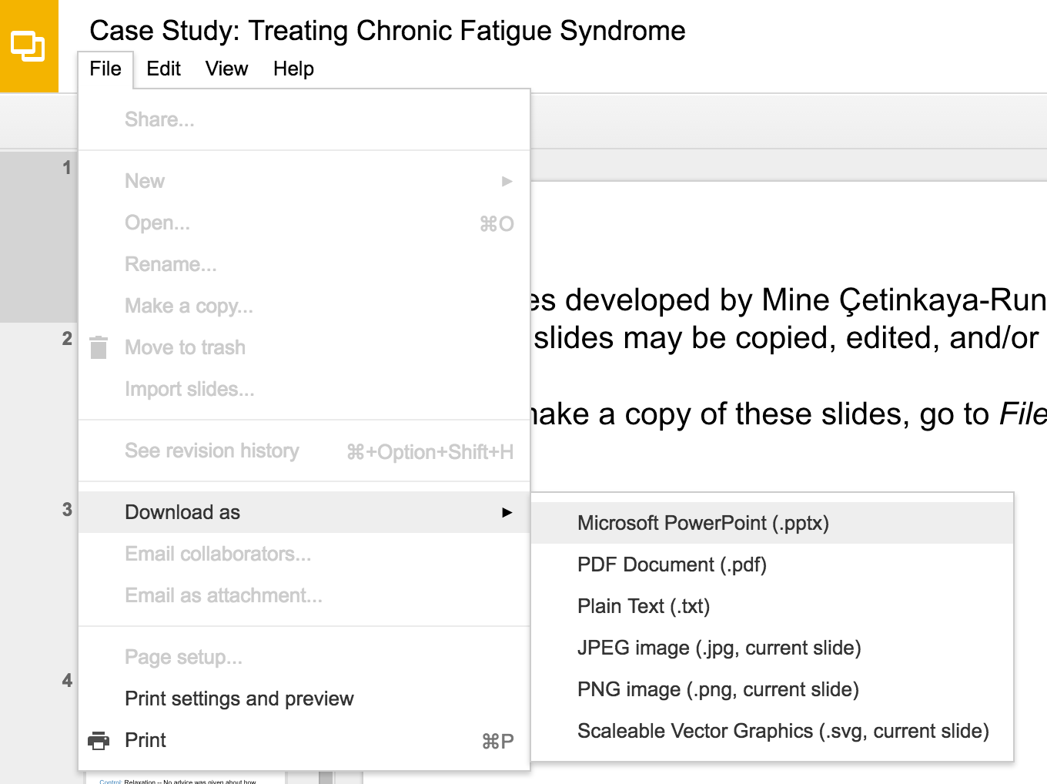
Slides developed by Mine Çetinkaya-Rundel of OpenIntro
Translated from LaTeX to Google Slides by Curry W. Hilton of OpenIntro.
The slides may be copied, edited, and/or shared via the CC BY-SA license
To make a copy of these slides, go to File > Download as > [option], as shown below. Or if you are logged into a Google account, you can choose Make a copy... to create your own version in Google Drive.

Slide 2
Negative binomial distribution

Slide 3
Negative binomial distribution
The negative binomial distribution describes the probability of observing the kth success on the nth trial.
The following four conditions are useful for identifying a negative binomial case:
The trials are independent.
Each trial outcome can be classified as a success or failure.
The probability of success (p) is the same for each trial.
The last trial must be a success.
Note that the first three conditions are common to the binomial distribution.
Negative binomial distribution
where p is the probability that an individual trial is a success. All trials are assumed to be independent.

Slide 4
Practice
A college student working at a psychology lab is asked to recruit 10 couples to participate in a study. She decides to stand outside the student center and ask every 5th person leaving the building whether they are in a relationship and, if so, whether they would like to participate in the study with their significant other. Suppose the probability of finding such a person is 10%. What is the probability that she will need to ask 30 people before she hits her goal?

Slide 5
Practice
A college student working at a psychology lab is asked to recruit 10 couples to participate in a study. She decides to stand outside the student center and ask every 5th person leaving the building whether they are in a relationship and, if so, whether they would like to participate in the study with their significant other. Suppose the probability of finding such a person is 10%. What is the probability that she will need to ask 30 people before she hits her goal?
Given: p = 0.10, k = 10, n = 30. We are asked to find the probability of 10th success on the 30th trial, therefore we use the negative binomial distribution.

Slide 6
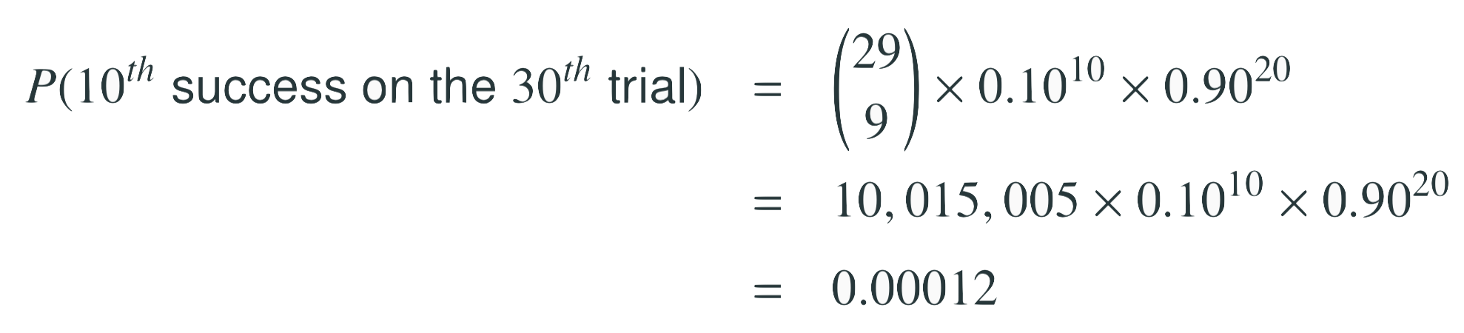
Practice
A college student working at a psychology lab is asked to recruit 10 couples to participate in a study. She decides to stand outside the student center and ask every 5th person leaving the building whether they are in a relationship and, if so, whether they would like to participate in the study with their significant other. Suppose the probability of finding such a person is 10%. What is the probability that she will need to ask 30 people before she hits her goal?
Given: p = 0.10, k = 10, n = 30. We are asked to find the probability of 10th success on the 30th trial, therefore we use the negative binomial distribution.

Slide 7
Practice
A college student working at a psychology lab is asked to recruit 10 couples to participate in a study. She decides to stand outside the student center and ask every 5th person leaving the building whether they are in a relationship and, if so, whether they would like to participate in the study with their significant other. Suppose the probability of finding such a person is 10%. What is the probability that she will need to ask 30 people before she hits her goal?
Given: p = 0.10, k = 10, n = 30. We are asked to find the probability of 10th success on the 30th trial, therefore we use the negative binomial distribution.

Slide 8
Practice
A college student working at a psychology lab is asked to recruit 10 couples to participate in a study. She decides to stand outside the student center and ask every 5th person leaving the building whether they are in a relationship and, if so, whether they would like to participate in the study with their significant other. Suppose the probability of finding such a person is 10%. What is the probability that she will need to ask 30 people before she hits her goal?
Given: p = 0.10, k = 10, n = 30. We are asked to find the probability of 10th success on the 30th trial, therefore we use the negative binomial distribution.

Slide 9
Practice
A college student working at a psychology lab is asked to recruit 10 couples to participate in a study. She decides to stand outside the student center and ask every 5th person leaving the building whether they are in a relationship and, if so, whether they would like to participate in the study with their significant other. Suppose the probability of finding such a person is 10%. What is the probability that she will need to ask 30 people before she hits her goal?
Given: p = 0.10, k = 10, n = 30. We are asked to find the probability of 10th success on the 30th trial, therefore we use the negative binomial distribution.

Slide 10
Binomial vs negative binomial
How is the negative binomial distribution different from the binomial distribution?

Slide 11
Binomial vs negative binomial
How is the negative binomial distribution different from the binomial distribution?
In the binomial case, we typically have a fixed number of trials and instead consider the number of successes.
In the negative binomial case, we examine how many trials it takes to observe a fixed number of successes and require that the last observation be a success.

Slide 12
Practice
Which of the following describes a case where we would use the negative binomial distribution to calculate the desired probability?
(a) Probability that a 5 year old boy is taller than 42 inches.
(b) Probability that 3 out of 10 softball throws are successful.
(c) Probability of being dealt a straight flush hand in poker.
(d) Probability of missing 8 shots before the first hit.
(e) Probability of hitting the ball for the 3rd time on the 8th try.

Slide 13
Practice
Which of the following describes a case where we would use the negative binomial distribution to calculate the desired probability?
(a) Probability that a 5 year old boy is taller than 42 inches.
(b) Probability that 3 out of 10 softball throws are successful.
(c) Probability of being dealt a straight flush hand in poker.
(d) Probability of missing 8 shots before the first hit.
(e) Probability of hitting the ball for the 3rd time on the 8th try.

